Slide 1
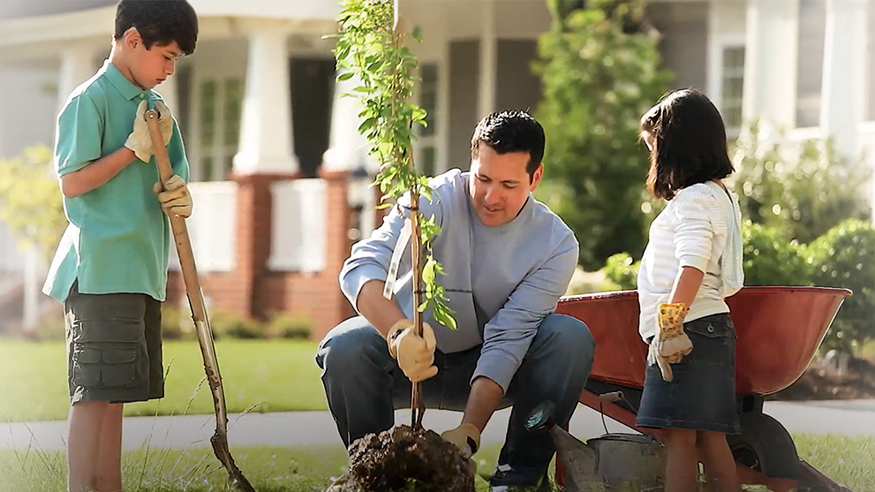
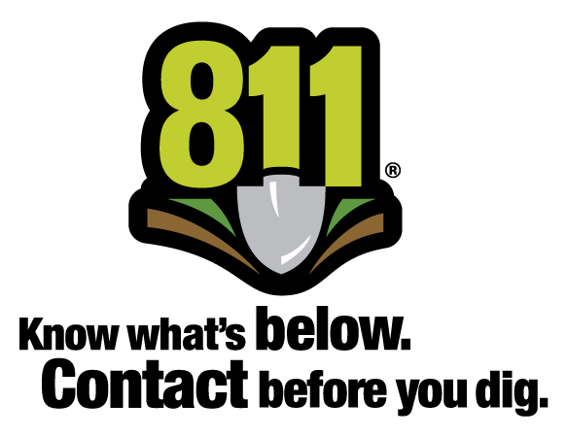
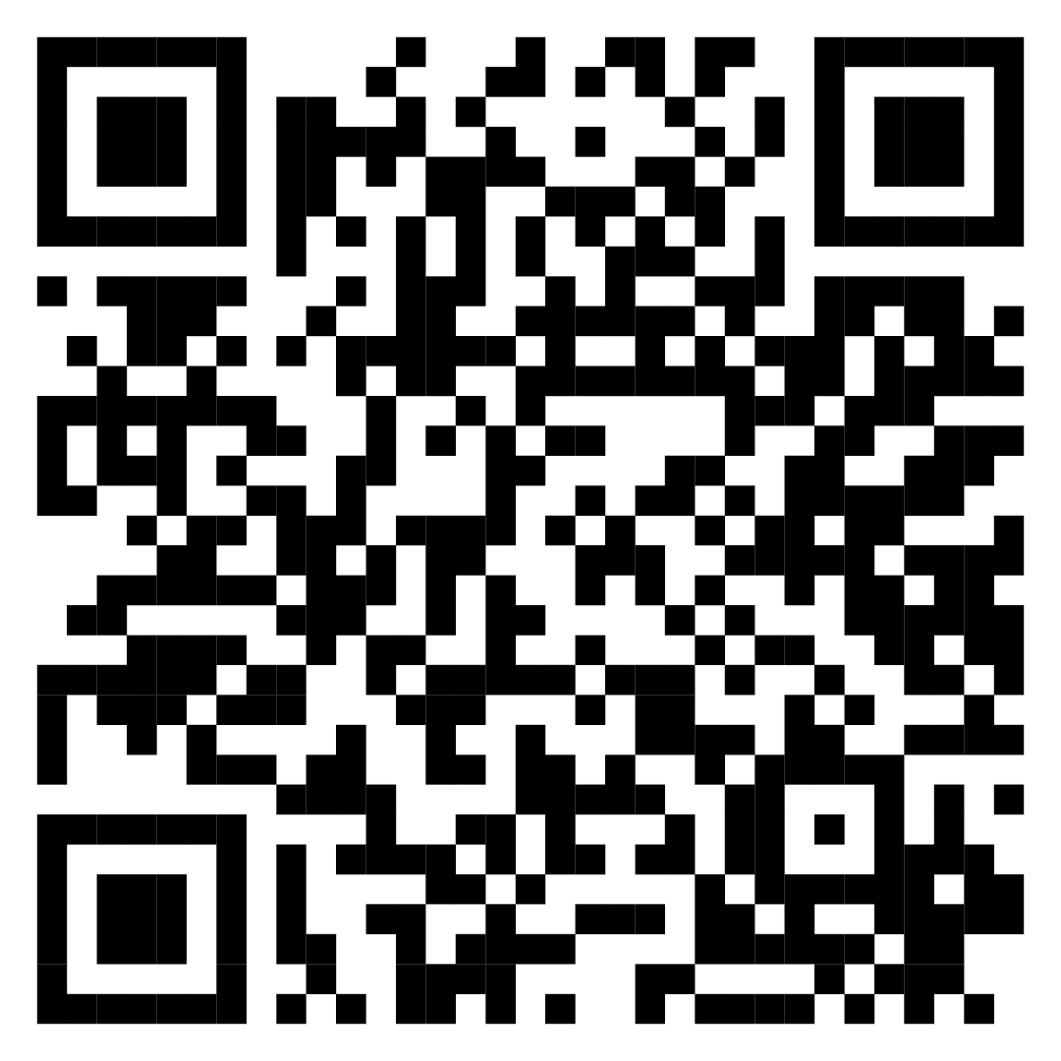
Safety Minute: Call Before You Dig
Benefits to calling 811 before you dig
Helps decrease potential damage to underground utilities
Identifies underground utility lines in unexpected locations
Avoids costly fines from utilities, cities/counties, and the Public Service Commission
It’s free and it’s the law!
Scan to learn more about safe digging

Slide 2
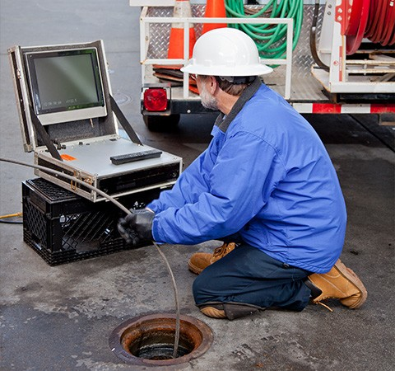
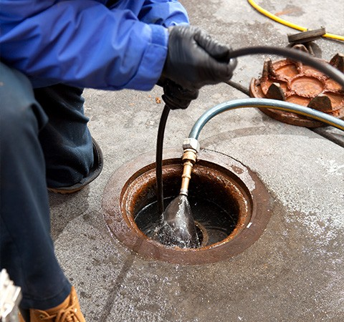
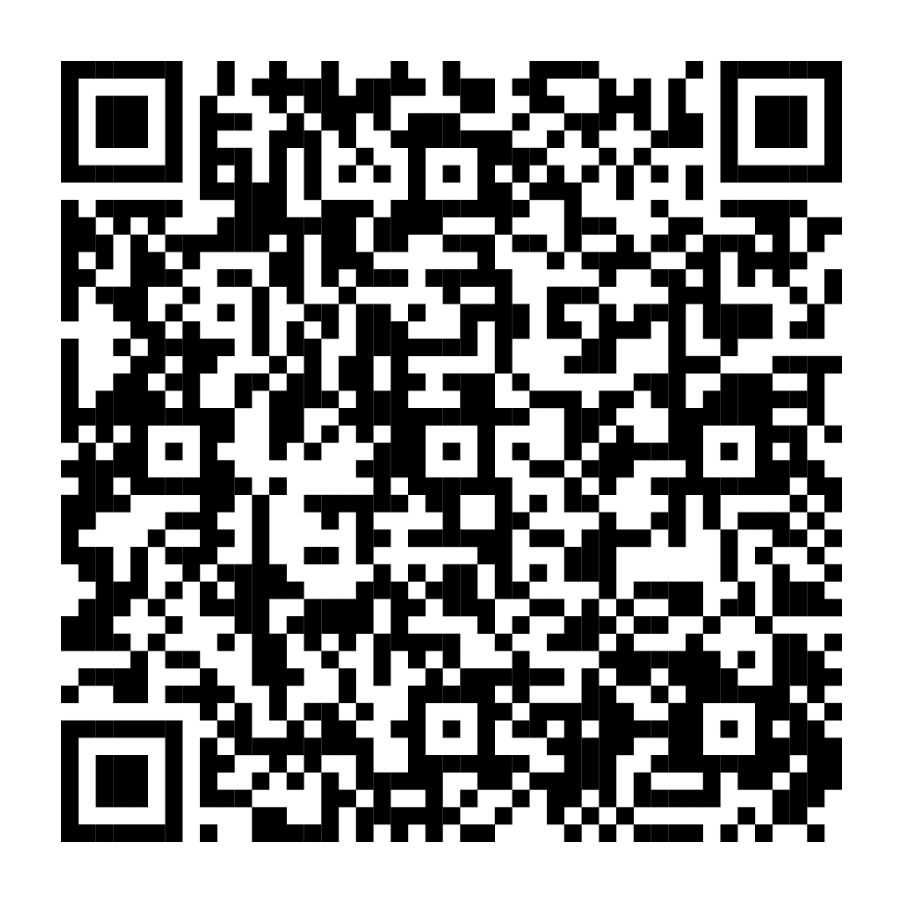
Safety Minute: Call Before You Dig
Cross Bore Safety
Use the ACT Method:
  Assume all sewer obstructions outside the building will involve a cross bore.
  Contact 811 to have all utility lines marked before you assess or clear an obstruction. It’s free and it’s the law.
  Take every safety precaution.
Exercise extreme caution when using power tools to clear an obstruction.
Scan to learn
more about
cross bore safety

